Slide 1

CSCE5300 SPRING 2024 PROJECT
GROUP 2

Slide 2

AGENDA
TEAM MEMBERS
GOALS & OBJECTIVES
MODEL
WORKFLOW
DATASET
ANALYSIS OF DATA
IMPLEMENTATION
RESULTS
PROJECT MANAGEMENT

Slide 3

TITLE - THE PREDICTIVE AND SUCCESSFUL FUNDING OF YOUNG OR EARLY-STAGE ENTERPRISES

Slide 4

TEAM MEMBERS
Team 2 Members
Deepak Adimoolam
Venkateswarlu Amireddy
Richard Correia
Arun Kumar Reddy Kandula

Slide 5
GOALS AND OBJECTIVES (Richard)
MOTIVATION
Finance related – interest to team
Aspirations to participate in the venture markets as an investor or inventor
One of the areas that is ripe for improvements in research and prediction
SIGNIFICANCE
Real world applicable – maximize the return on investments
Many organizations that lend or fund companies, are looking for ways to predict areas to focus on
Area that needs a lot more work
OBJECTIVES
Create a solution based on a clean and simple architecture, where the data, processing and analysis are done within integrated system
Optimize cost, effort and processing time
Clean, combine, adjust/process, query/analyze the data. Predict what can lead to survive
FEATURES
Leveraged AWS S3 and Sagemaker
All activities (load data, process data, analyze, and apply machine learning) within one platform, AWS
Designed to support future iterations of work started
Focused on key factors (industries, funding) to determine success of enterprises

Slide 6
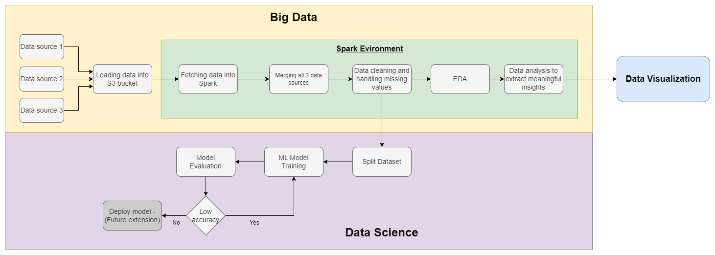
MODEL (Deepak)
Highlights
Supports different types of data
Using S3 Bucket for storage medium and for input and output of data
All pre-processing and processing performed on Sagemaker using spark session
Queries and ML modeling done on Sagemaker (Jupyter lab/Python 3)
Data Visualization is performed using Matplotlib

Slide 7
Why Sagemaker? (deepak) (I think we should take this slide out coz I ran in Ec2)
Tried Ec2 t2.micro - could install and work on pyspark because of ram issue (t2.micro has only 1gb of RAM)
Tried EMR, could install pyspark and setup jupyter notebook but couldn’t connect to the jupyter notebook from browser.
Finally set up Ec2 t2.x2large instance which has 32gb of RAM. Pyspark and jupyter notebook were installed but we had the same accessing issue of jupyter notebook from the browser.

Slide 8
WORKFLOW (arun)
Query Part
Load 3 files (2 x CSV, 1 x TXT) into AWS S3
Clean the data (remove any rows that have missing values, ensure within columns follow same format, reduce data to lowercase)
Combine the files based on company names and category lists
Remove duplicate data
Aggregate some of the rows into the combined headings (categories into industries)
Pivot the categories under source of funding column into separate columns
Perform 5 queries and data visualizations

Slide 9
WORKFLOW (arun)
ML Part
Index categorical columns
Focus on data features such country code, status, sources of funding, industries and amount funded
Remove all non-feature columns
Focus on classification models, decision tree and random forest to help optimize
Outcome value to classify was status (operating, acquired, IPO, not in operation)

Slide 10
DATASET (arun)
3 datasets
compnaies.txt
mapping.csv
rounds.csv
Features
Companies have features like, name of the company, category, country, state, region, founded on, status (operation, closed, IPO, etc)
mappings have info related to the industry of the company. Like, automotive, health, manufacturing, etc. We can merge this with companies using “category_list”.
Rounds have information of the type of funding (seed, venture, angel) and the amount raised. This dataset can be merged with companies using “company_permalink”.

Slide 11
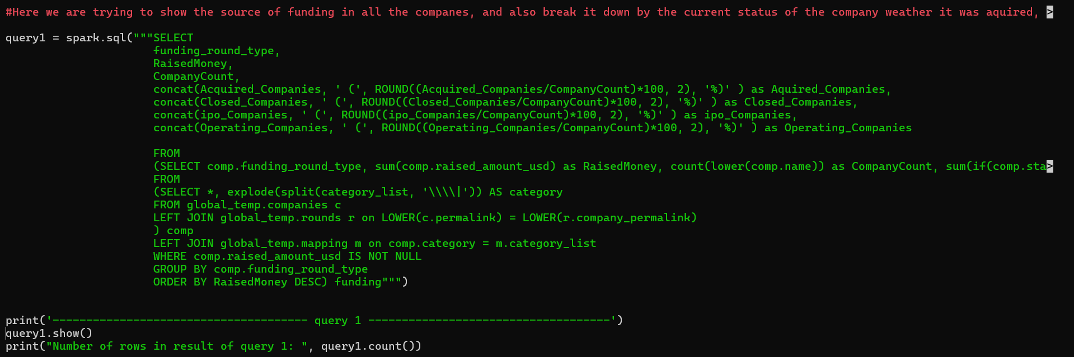
Query 1 (Arun)

Slide 12
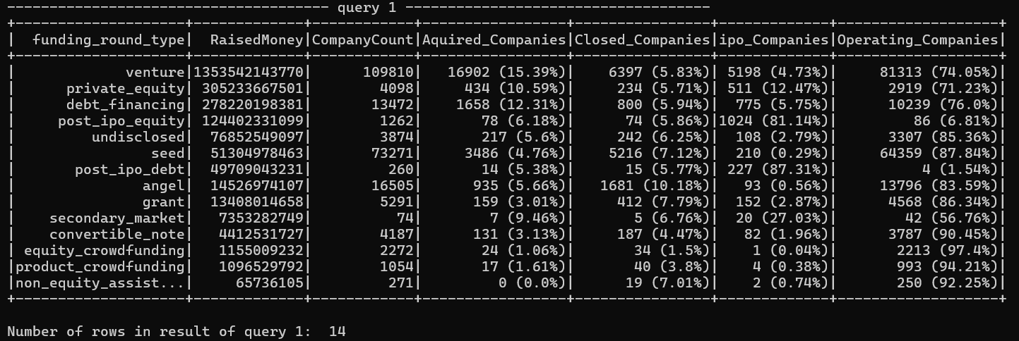
Query 1 - Result (Arun)

Slide 13
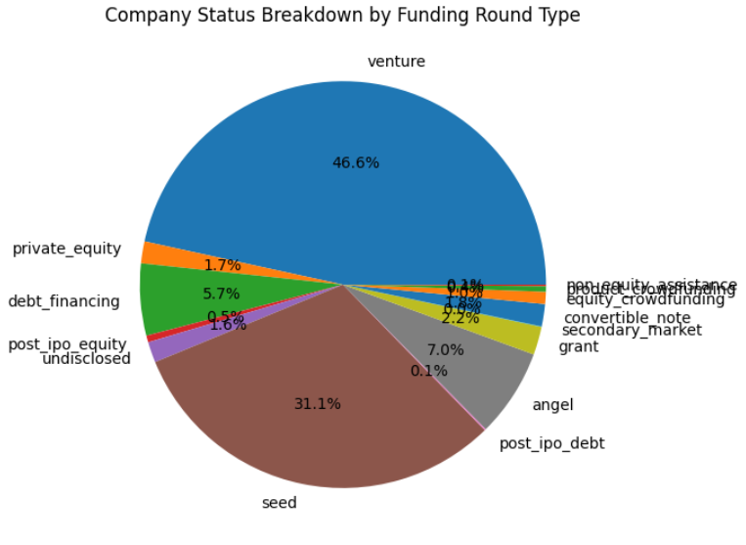
Query 1 - Visualization (Arun)

Slide 14
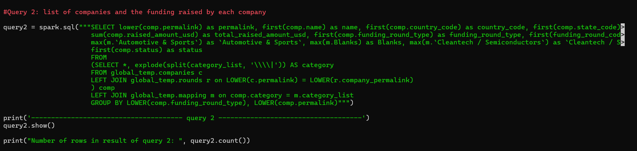
Query 2 (Arun)

Slide 15
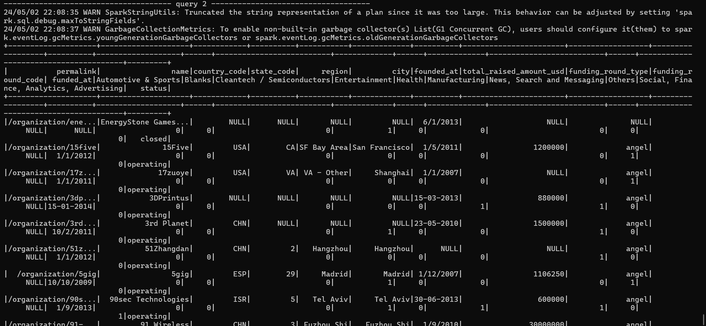
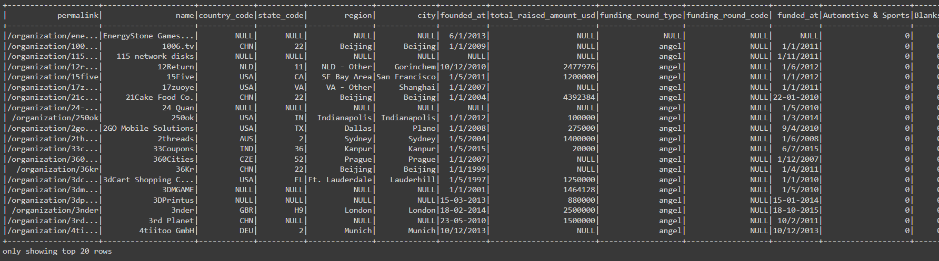
Query 2 - Result (Arun)
No. of rows: 79070

Slide 16
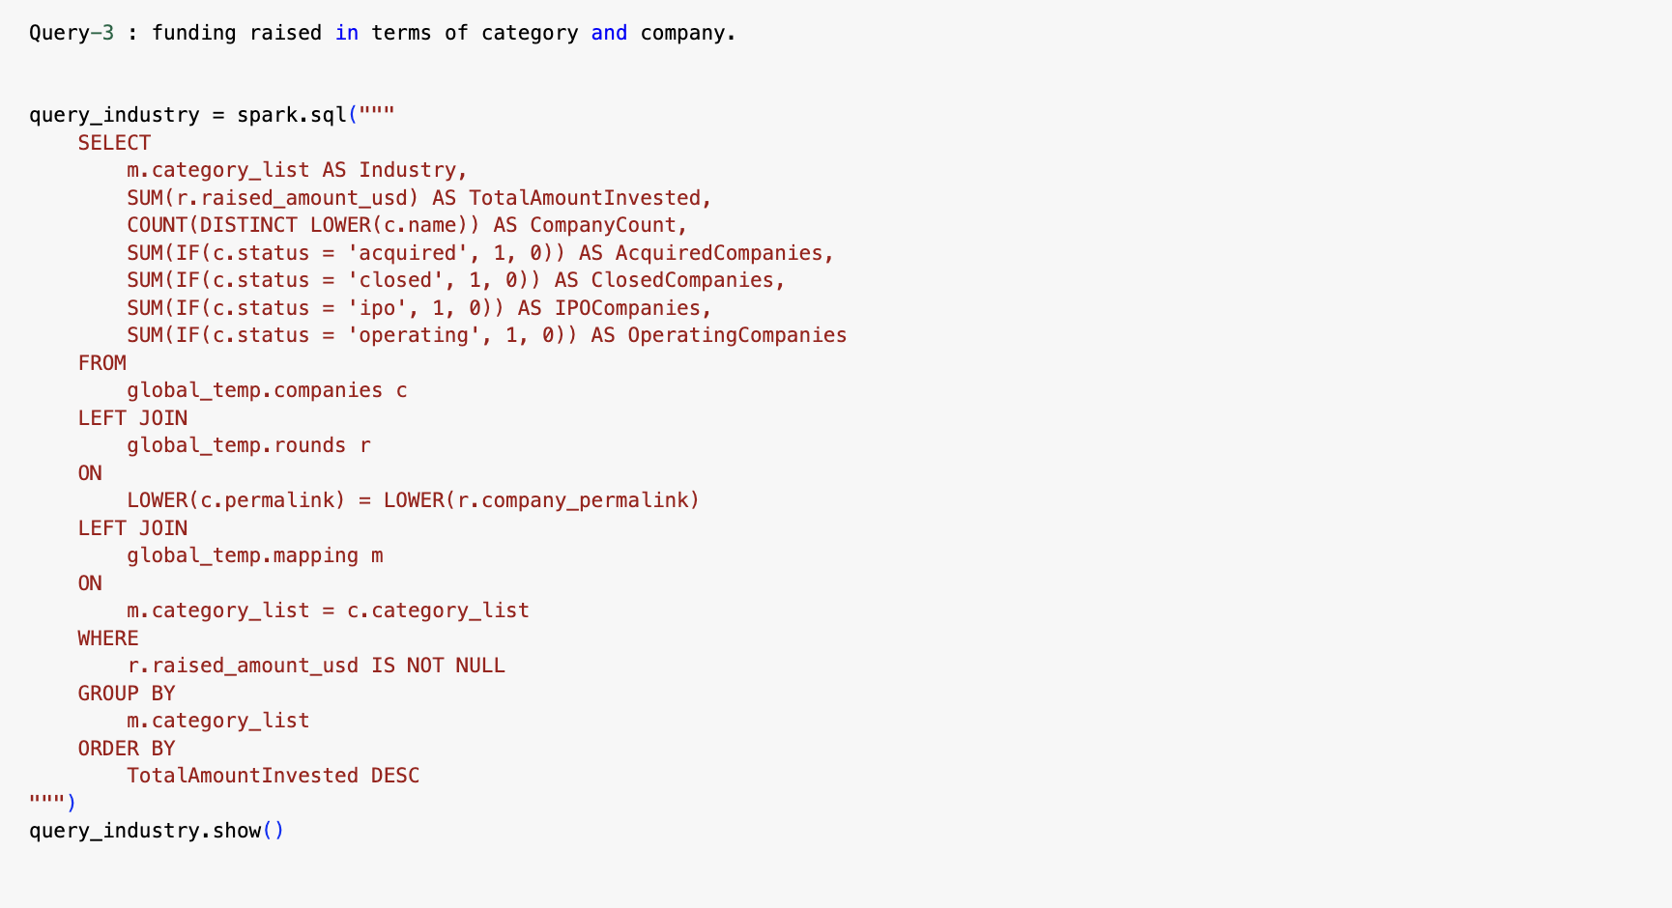
Query 3 (Venkat)

Slide 17
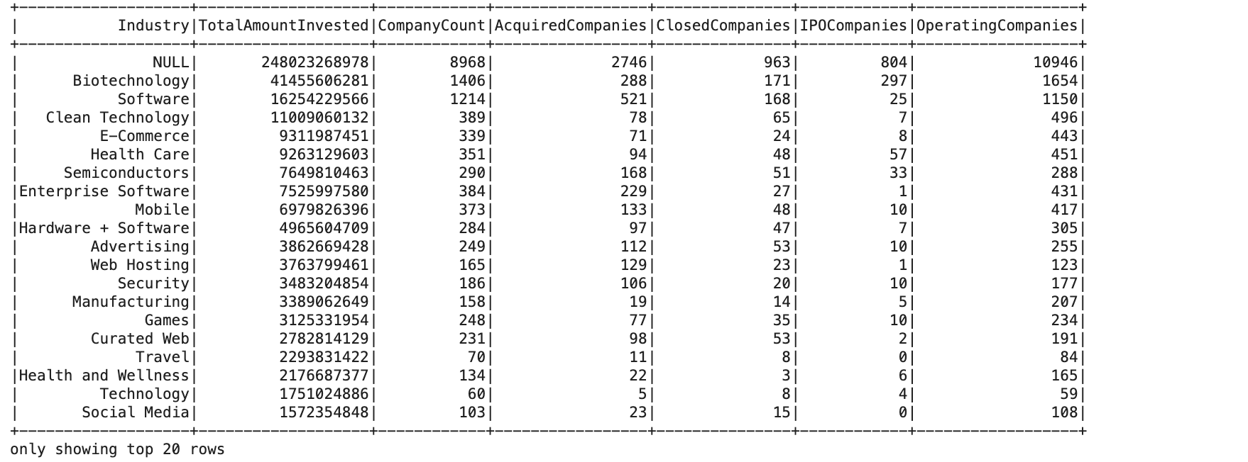
Query 3 (Venkat)

Slide 18
IMPLEMENTATION (venkat)
INTEGRATION
2 x CSV files, 1 x txt
AWS
S3
Sagemaker
EC2
IMPLEMENTATION
S3 storage
Sagemaker & EC2
Jupyter Lab
Python 3 notebook
All of the queries and ML were done in Spark

Slide 19
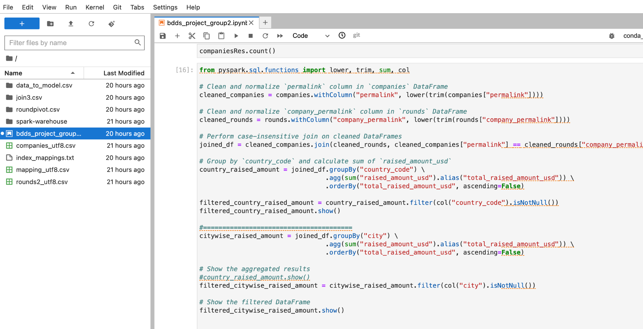
Query 4 (Deepak)
To show country wise
and city wise amount
invested by successful startups

Slide 20
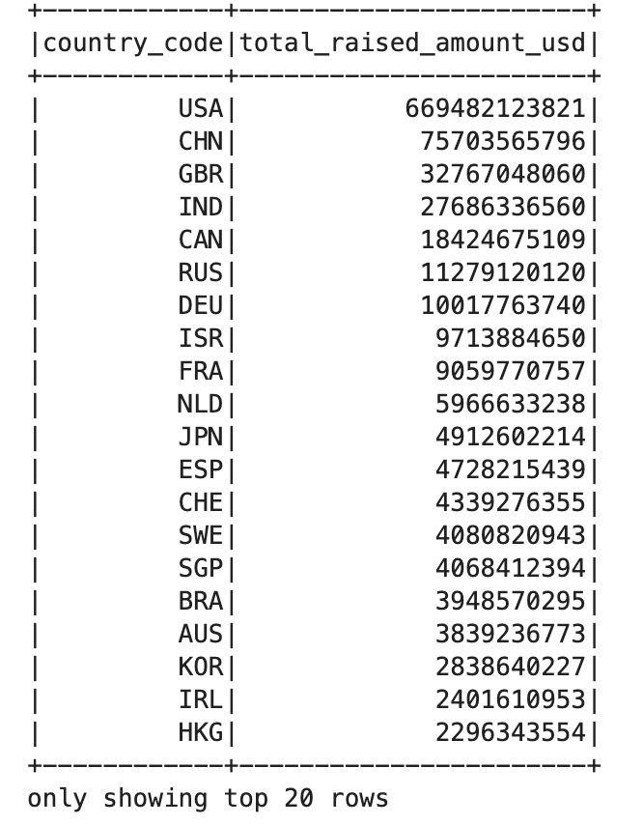
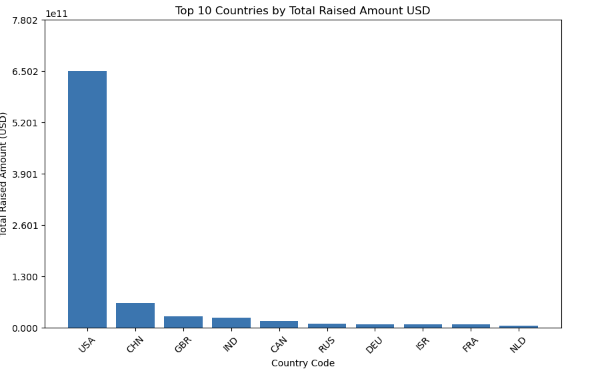
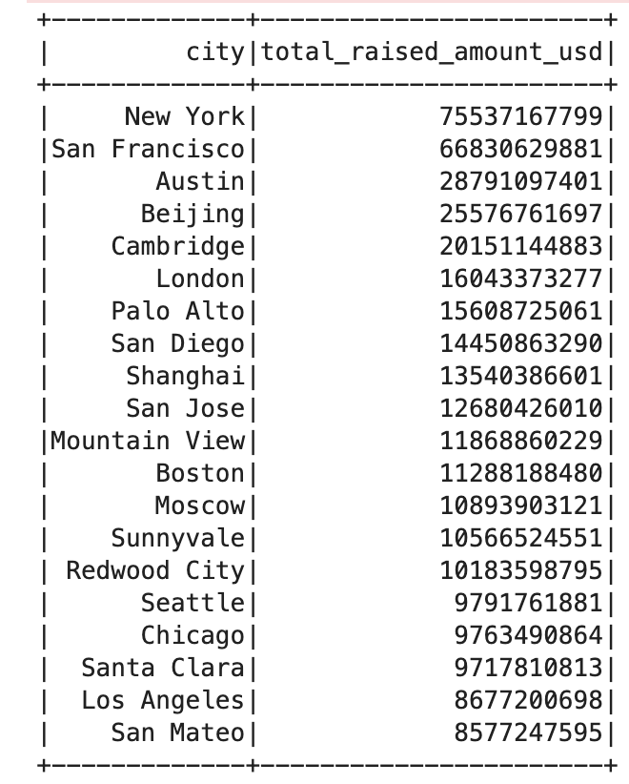
Query 1 (Deepak)
To show country wise and city wise amount invested by successful startups

Slide 21
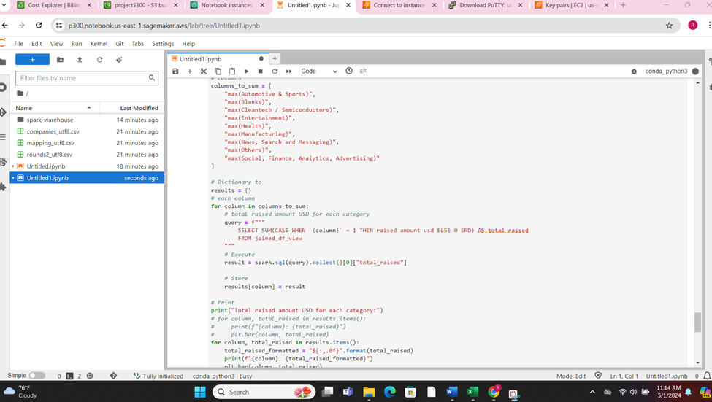
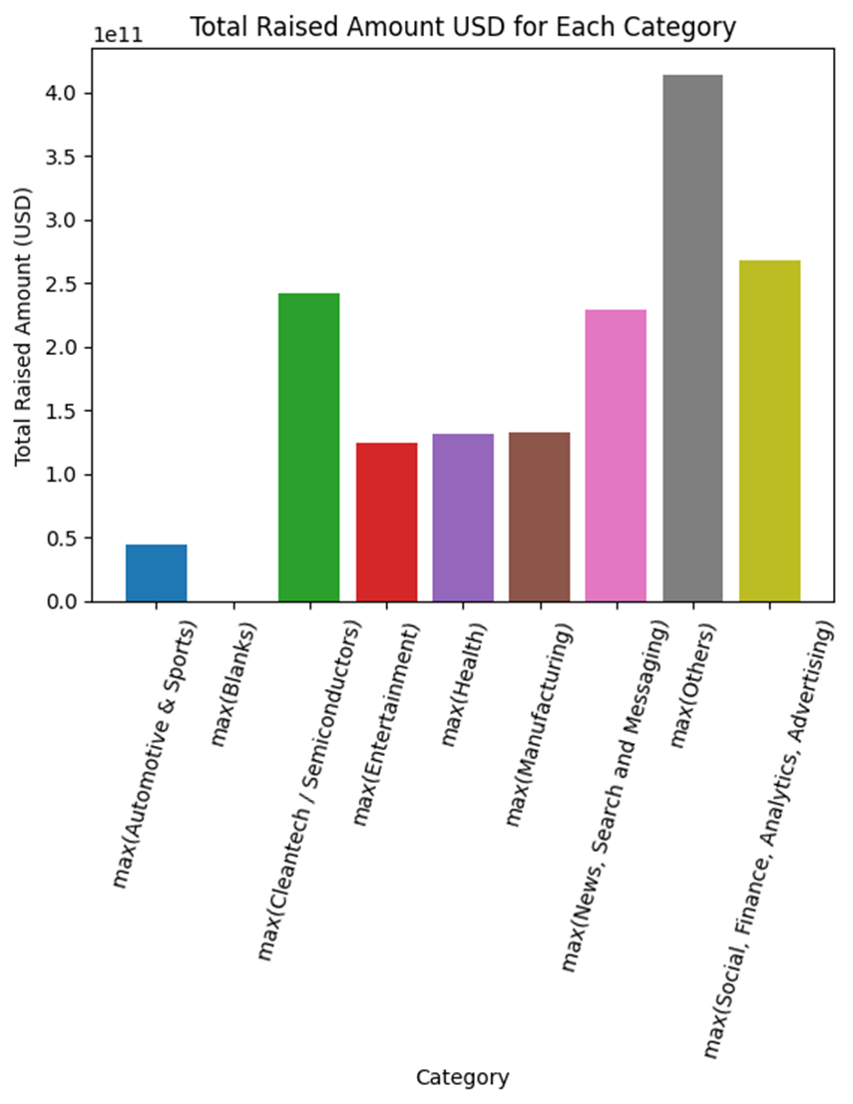
Query 5 (Richard)
Total raised amount USD for each category:
max(Automotive & Sports): $44,786,697,961
max(Blanks): $0
max(Cleantech / Semiconductors): $242,201,184,352
max(Entertainment): $123,999,473,406
max(Health): $131,629,176,909
max(Manufacturing): $132,375,114,676
max(News, Search and Messaging): $228,977,881,530
max(Others): $413,752,698,535
max(Social, Finance, Analytics, Advertising): $268,089,097,295

Slide 22
ANALYSIS OF DATA (richard)
DATA PREPROCESSING
Remove any rows with missing or NULL values
Ensure that columns were consistent on format
Remove inconsistencies with uppercase and lowercase
Combine all 3 files based on company and category list
Expand company categories and apply them to the specific industry classifications
Pivot the sources of funding column into separate colums
Discretize the raised amounts column
Index the categorical columns
Used decision tree modeling, along with random forest, to predict status
QUERIES
Query by country and city for amounts raised
Query by industry and amounts raised
Query by sources of funding and status
Query by industry and amounts raised, broken out by status
Query and aggregate by applycable industries since some enterprises can be classified across several

Slide 23
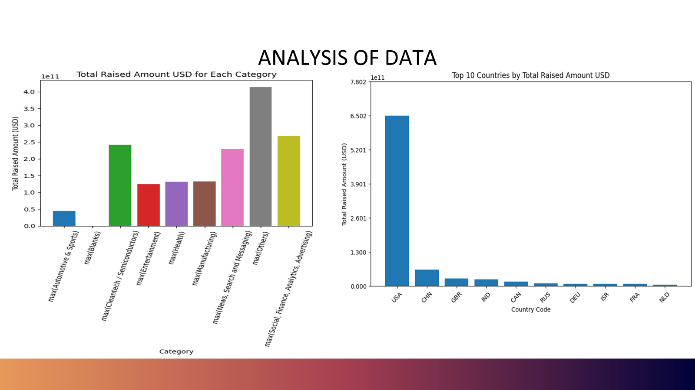
Notes:
Richard

Slide 24
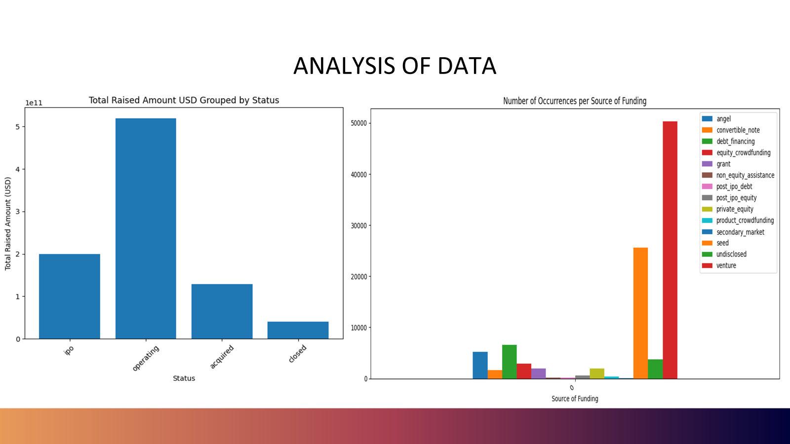
Notes:
Richard

Slide 25
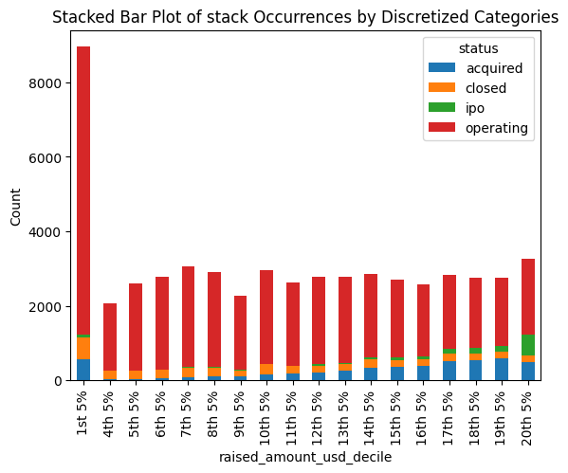
ANALYSIS OF DATA

Slide 26
RESULTS (richard)
Class to predict – status (in operation, acquired, IPO, not in operations
Key features – industry, sources of funding, amounts raised, country
Models used – decision tree models
Optimization – random forest
Attempted Support Vector Machines (SVM), but multiclass > 2 not supported by MLlib
ML results
Accuracy: 0.815199562602515
Precision: 0.8158523876662784
Recall: 0.9993242228562847
F1-score: 0.7371493469512593
Best maxDepth: 10
Best numTrees: 10
Best featureSubsetStrategy: auto
Based on Best:
Accuracy: 0.8160500577121682
Precision: 0.8162026248006868
Recall: 0.9993242228562847
F1-score: 0.738377295657317

Slide 27
PROJECT MANAGEMENT (richard)
INDIVIDUAL/S | TASK |  | PERCENTAGES (%)
Richard | Query, Model building, Model training, Model evaluating, platform review, presentation |  | 25
Venkat | AWS Infrastructure setup, Query, Model evaluating |  | 25
Deepak | AWS Infrastructure setup, Query, Model evaluating, platform review, presentation |  | 25
Arun | Queries, Model building, Model training, Model evaluating, platform review |  | 25

Slide 28
BIBLIOGRAPHY
REFERENCE
https://blog.revolve.team/2023/05/02/data-files-from-s3-in-local-pyspark-environment/
https://phoenixnap.com/kb/hadoop-mapreduce
https://labelyourdata.com/articles/how-to-choose-a-machine-learning-algorithm
https://towardsdatascience.com/explainable-ai-xai-with-a-decision-tree-960d60b240bd
https://papers.ssrn.com/sol3/papers.cfm?abstract_id=3167812
https://www.analyticsvidhya.com/blog/2019/08/comprehensive-guide-k-means-clustering/

Slide 29

THANK YOU

